Slide 1
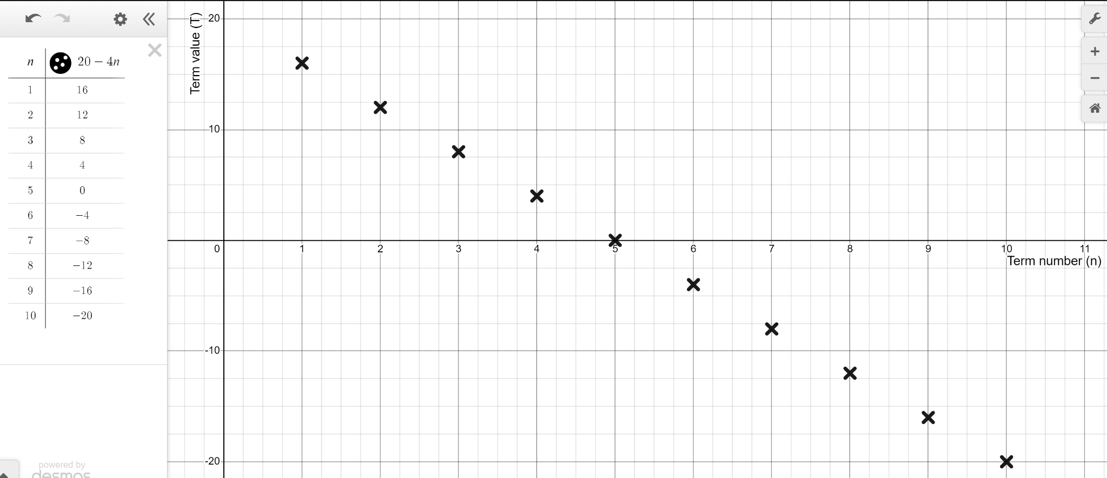
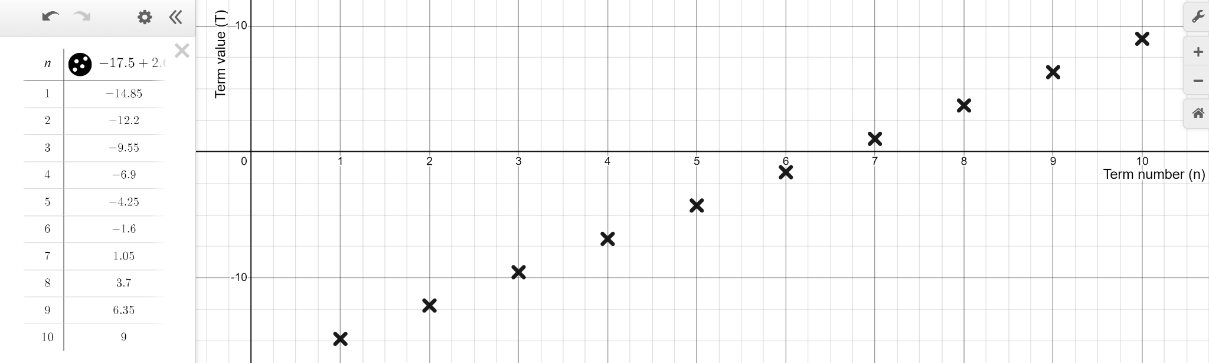
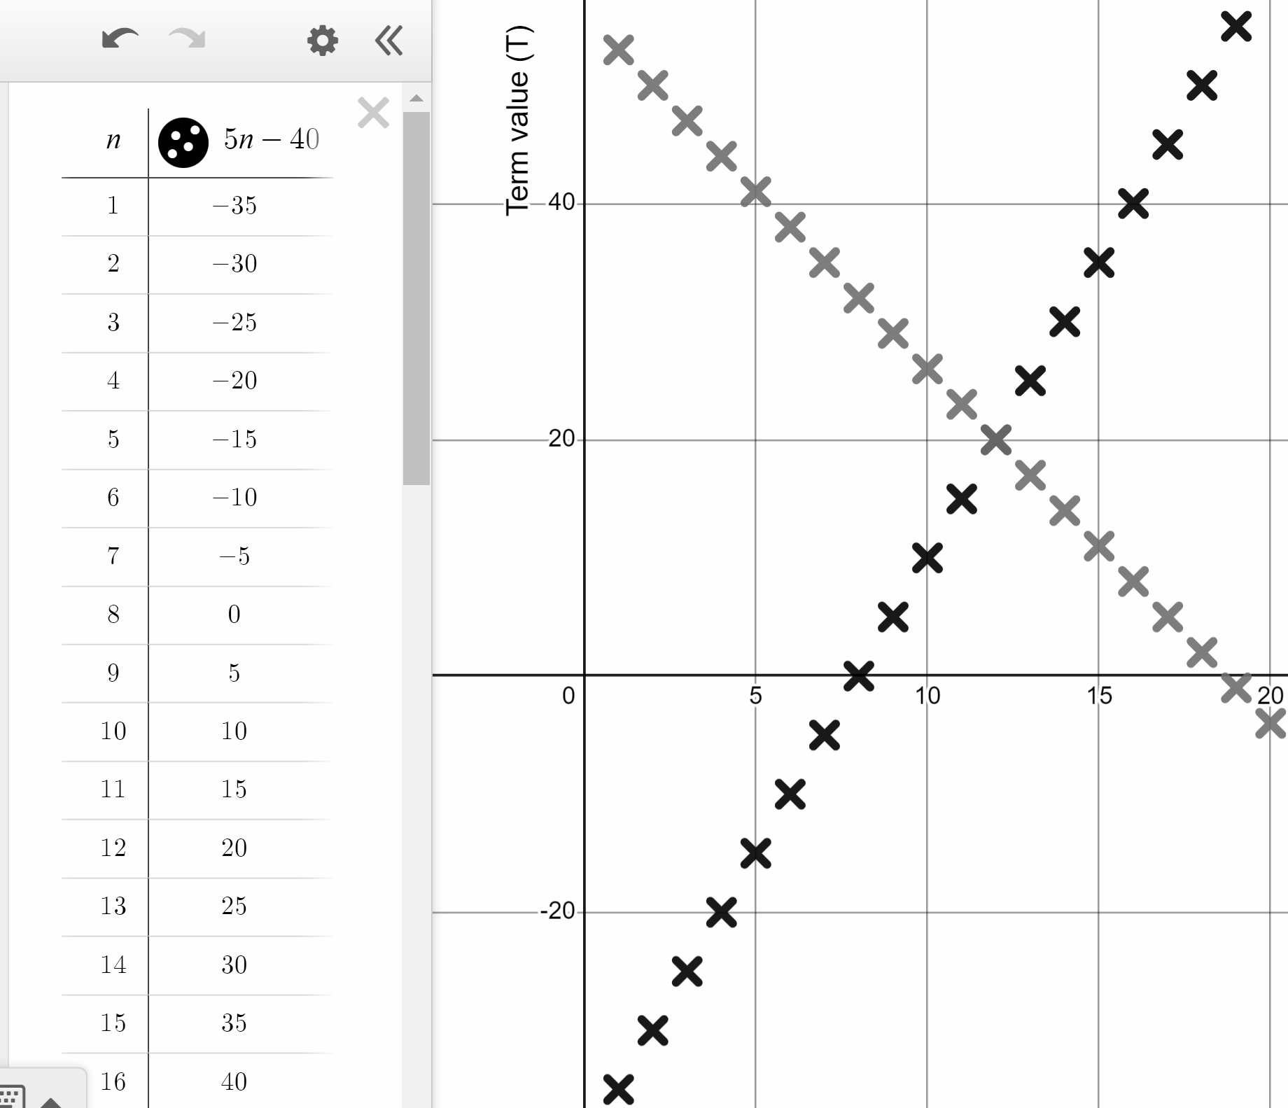
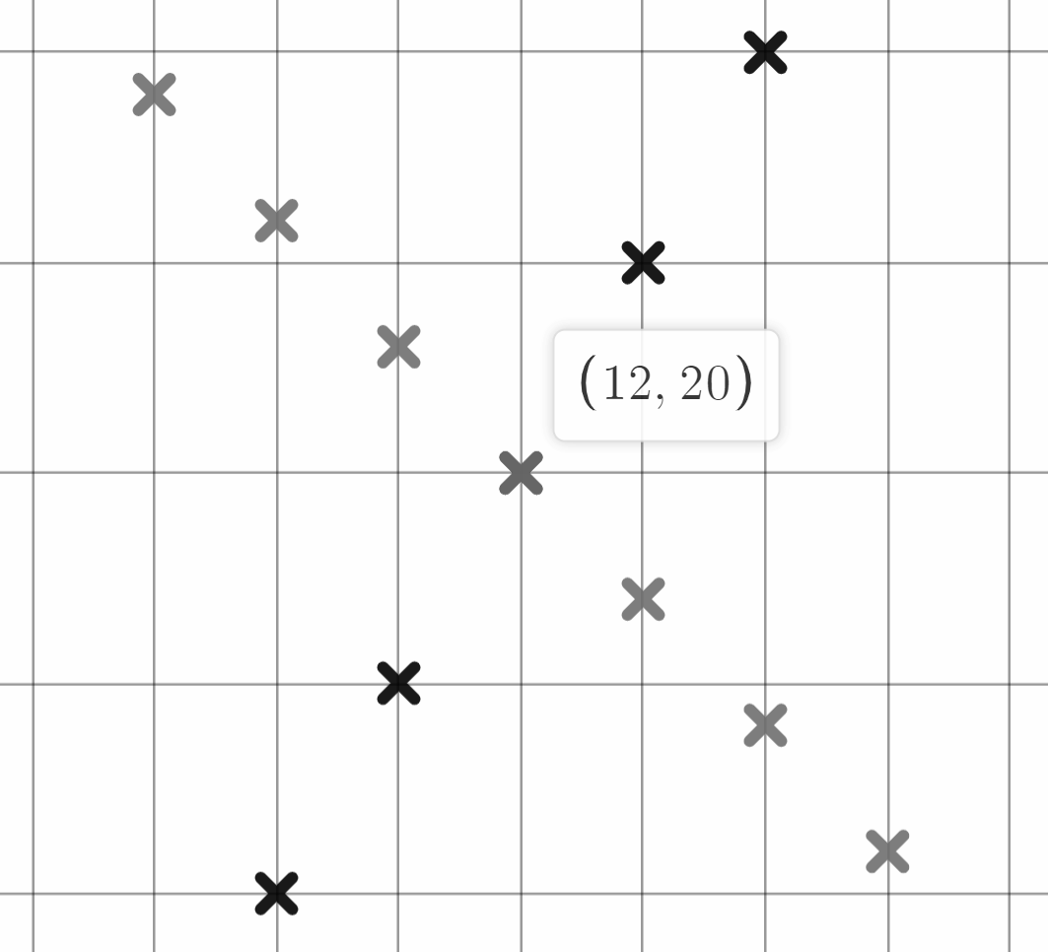
Checking and securing understanding of plotting coordinates with technology
Task A: Plotting sequences and rules using technology
1) Use the table function in Desmos to generate the first ten terms of the arithmetic sequence 20 − 4n
2) Use the table function to generate the first ten terms of the arithmetic sequence 2.65n − 17.5
Use your graphical representation to identify the first positive term.
The 7th term is the first positive one.
3) Use Desmos to explore if the sequences 5n − 40 and 56 − 3n share a common term.
Use the table function to plot multiple terms.
Zoom in and click on the shared coordinate.
The coordinates are in the form (n, T) so this is the 12th term with a value of 20
20 is a shared term.

Slide 2
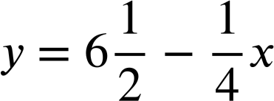
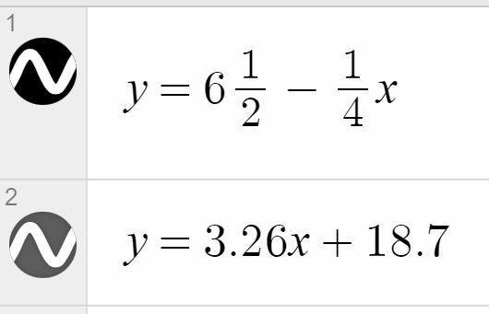
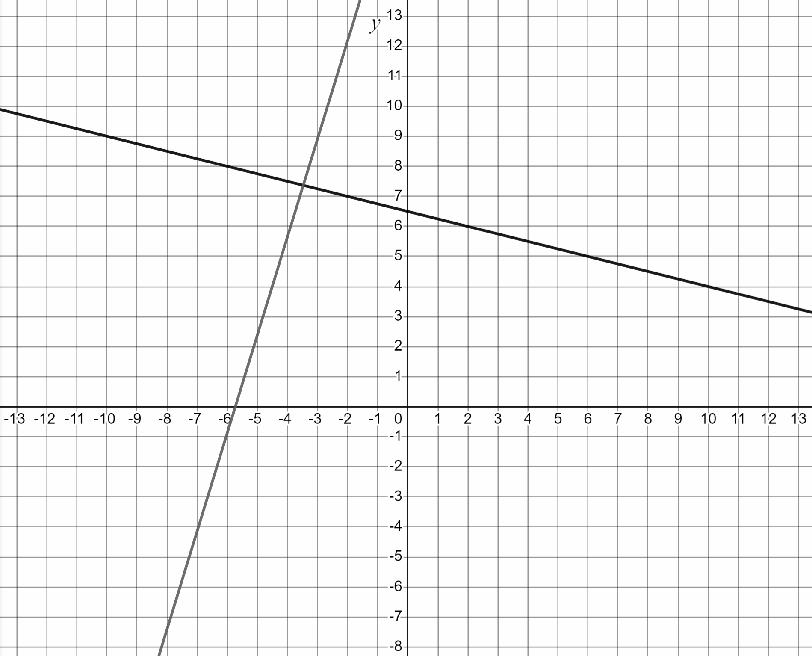
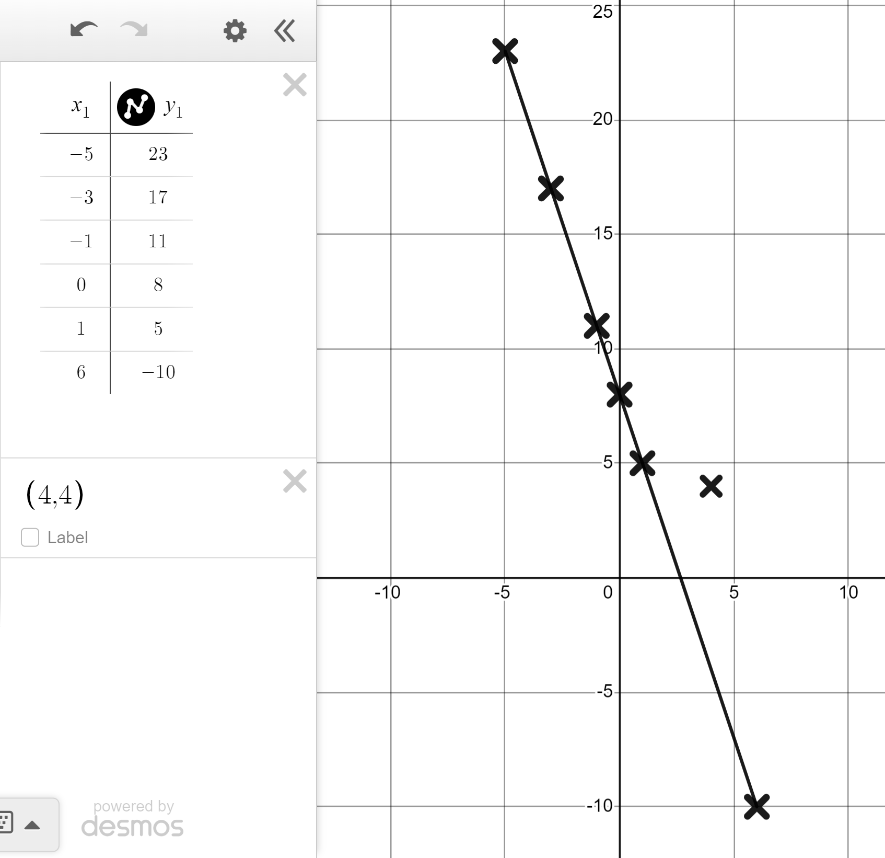
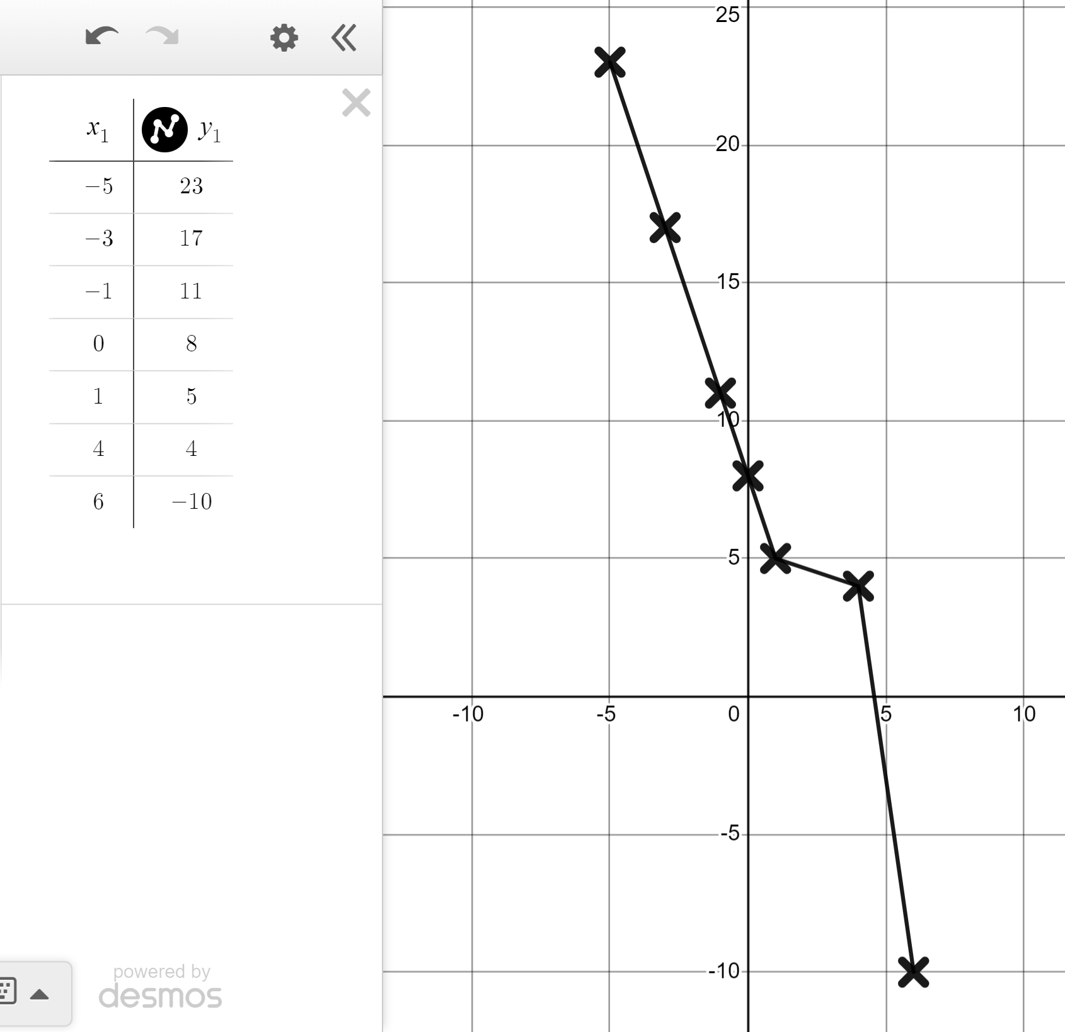
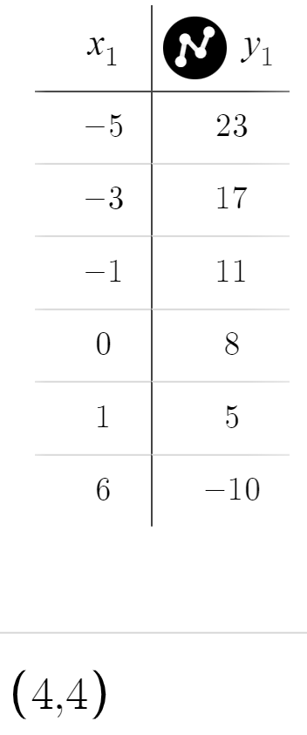
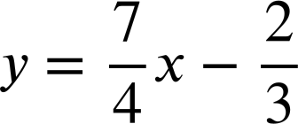
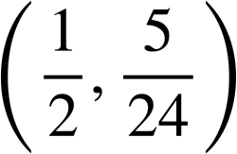

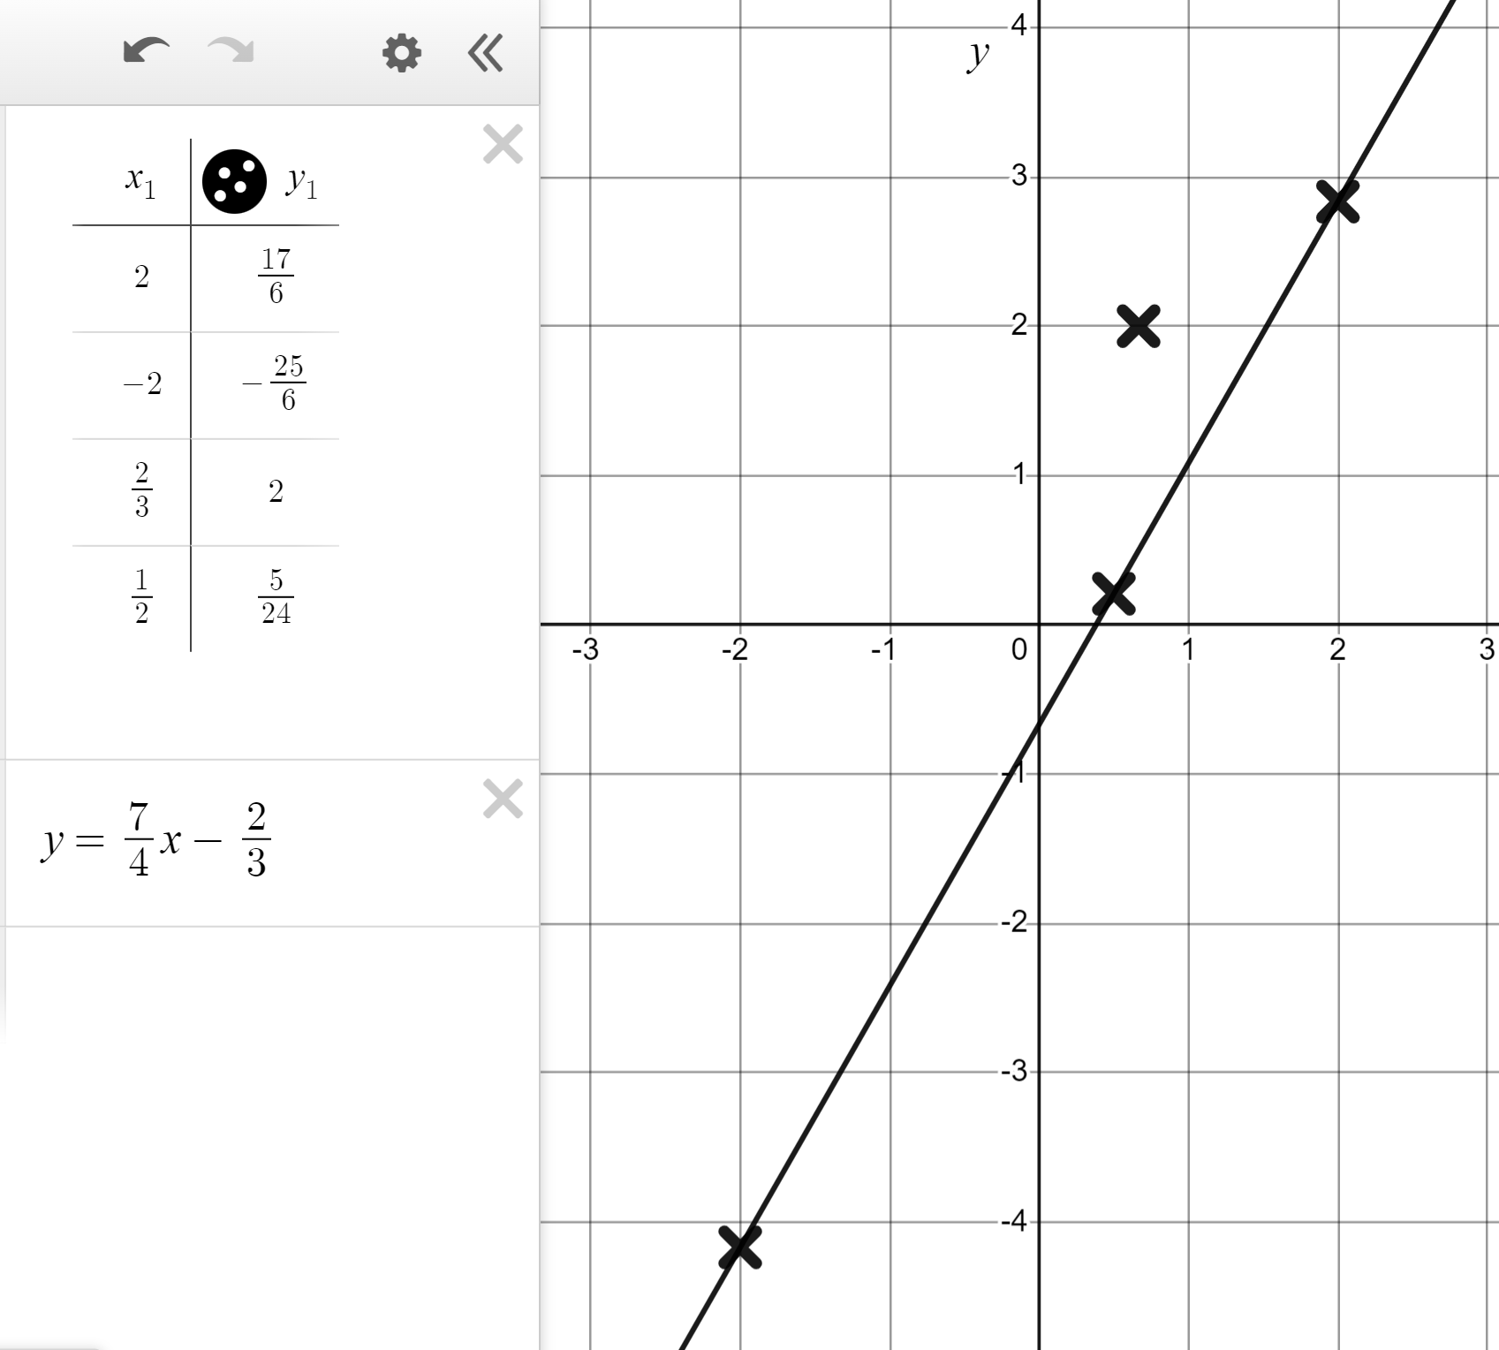
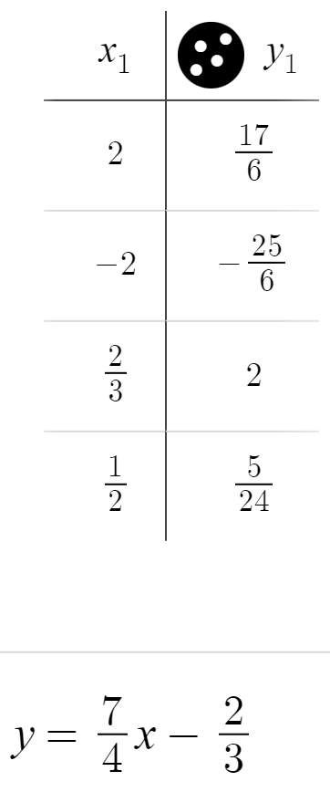
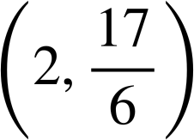
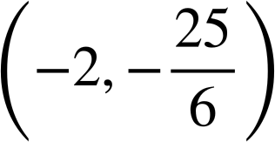
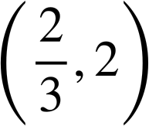
Checking and securing understanding of plotting coordinates with technology
4) Use Desmos to graphically represent the rules and y = 3.26x + 18.7
Identify the quadrant in which they intersect.
They intersect in the second quadrant.
Task B: Identifying if points fit a rule
1) Use Desmos to find which coordinate does not fit the same rule as the others.
(−5, 23)
(1, 5)
(−1,−11)
(0, 8)
(4, 4)
(−3, 17)
(6,−10)
Plot using a table for speed and switch on ‘lines’.
(4, 4) looks out of line.
Plot it separately to confirm that it does not fit the same rule.
2) Which coordinates fit the rule ?
does not fit the rule.

Slide 3
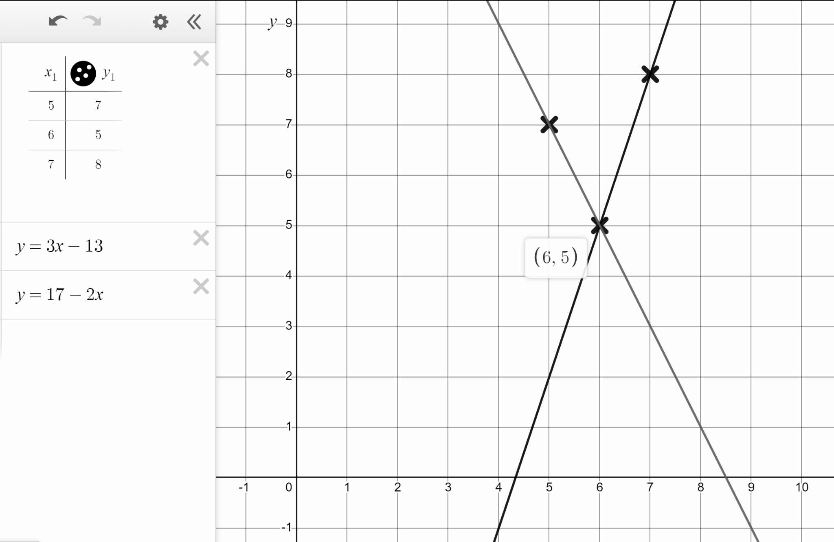
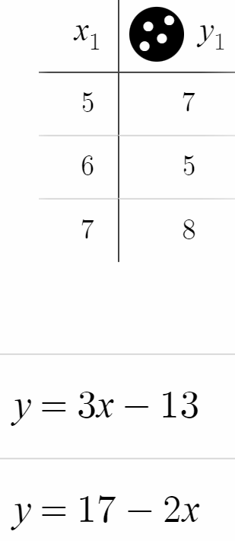
Checking and securing understanding of plotting coordinates with technology
3) Use Desmos to graphically represent the rules
y = 3x − 13 and y = 17 − 2x
Identify which of these three coordinates fits both rules.
(5, 7)
(6, 5)
(7, 8)
The coordinate (6, 5) fits both rules.
Mathematics in Education and Industry
v2.2

